Slide 1
Twitter Sentiment Analysis
Name:- Yash Bisht
Sec:-g
University Roll No:-2018872
Class Roll No:-62

Slide 2
Introduction
Twitter is a popular microblogging service where users create status messages (called "tweets").
These tweets sometimes express opinions about different topics.
Generally, this type of sentiment analysis is useful for consumers who are trying to research a product or service, or marketers researching public opinion of their company.
The purpose of this project is to build an algorithm that can accurately classify Twitter messages as positive or negative, with respect to a query term.

Slide 3
What is Sentiment Analysis?
Computational process for identifying and categorizing opinions expressed in a piece of text by taking a block of text as input and Determining the sentiment expressed in it.
Determining the writer's attitude towards a particular topic, product, etc. is positive, negative.

Slide 4
Disciplines Involved and Python Library used
Disciplines Involved
Natural Language Processing.
Data Mining.
Artificial Intelligence.
Python Library Used
Tweepy.
Textblob.
Flask.

Slide 5
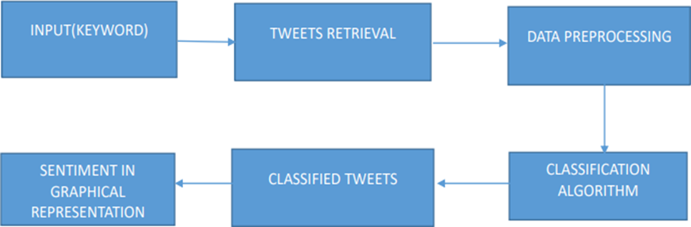
Flow Chart

Slide 6
Challenges Faced
Inadequate accuracy and performance in sentiment.
Incapability to deal with complex sentences that require more than sentiment words and simple analyzing.
abbreviations, lack of capitals, poor spelling, poor punctuation, poor grammar.
Named Entity Recognition.

Slide 7
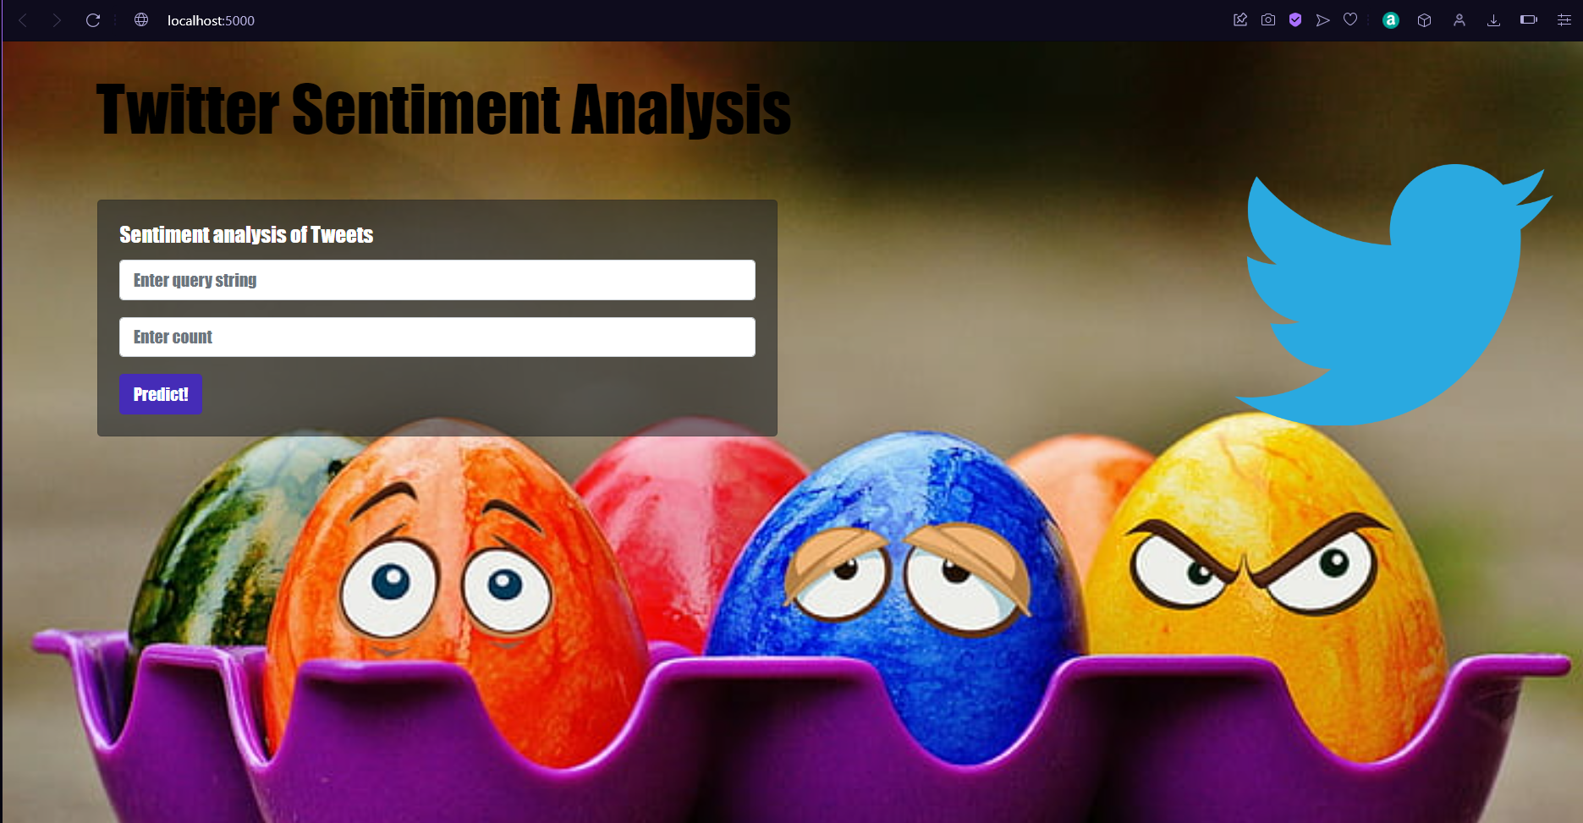
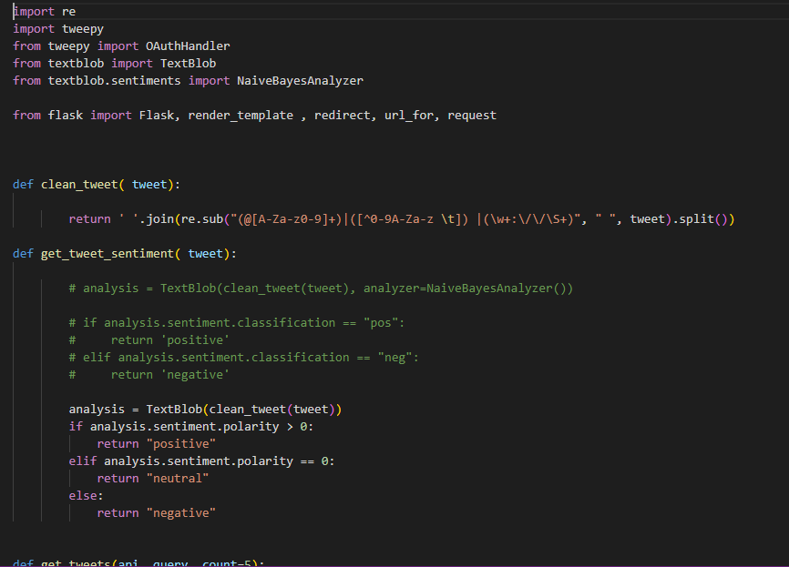
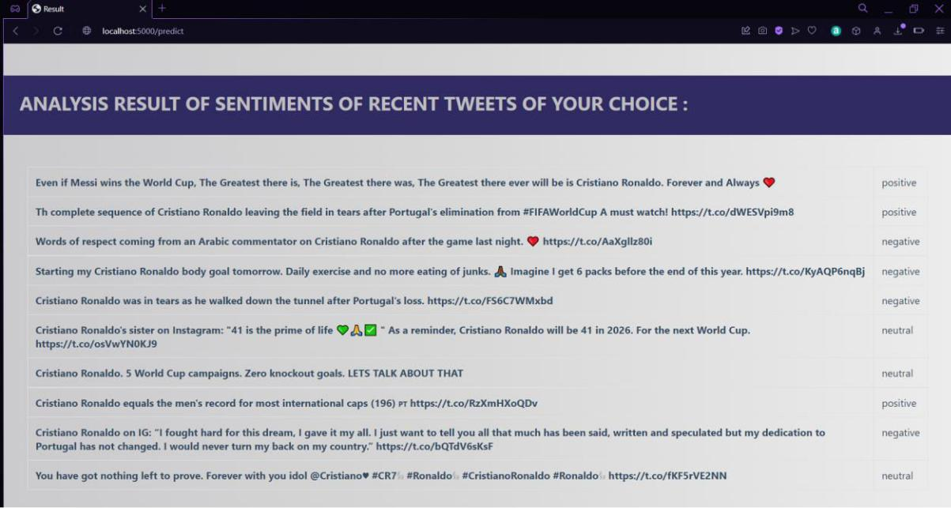
Project Snapshots

Slide 8
Conclusion and Future Scope
Overall this project was a great learning experience for me as it made me familiar with the concept of Artificial Intelligence, Machine learning, Data Mining and it also made comfortable with different python libraries such as tweepy and textblob.
For the future scope I would like to increase the accuracy of this project so that it can make more accurate judgments on the sentiments and overcome it’s shortcomings.

Slide 9
Thank You!

